Slide 1

Qualitative Impacts on Earnings Per US Citizen
Daniel Rusch
11/16/2020

Slide 2
It is a capital mistake to theorize before one has data.”
- Sherlock Holmes

Slide 3
Data Source: US Census Data
Each US citizen is required to complete a census. The collective data from all US citizens is stored in a massive database. This project used data from the 2019 US Census.
The data is made accessible using an API which reference HTML data via the Census Bureau website.
A python library called census 0.5 (https://pypi.org/project/census/0.5/) is available which can be used to access the Census data either using distinct Library commands or through referencing a website link and retrieving the data via web address.
Example of code used to call the primary data set:
work_age = requests.get("https://api.census.gov/data/timeseries/qwi/sa?get=sex,Emp,agegrp,EarnS,race,education&for=metropolitan%20statistical%20area/micropolitan%20statistical%20area:*&in=state:01&time=2019")

Slide 4
Value of US Census Data Analysis
Businesses, governments, and economists all must base decisions on their respective interpretation of the world around us. Data is integral to those decisions so that they may be grounded in reality.
By analyzing large data sets, observations may be made which may not be easily recognized.

Slide 5
Data Retrieval: API
The data is made accessible using an API which reference HTML data via the Census Bureau website.
A python library called census 0.5 (https://pypi.org/project/census/0.5/) is available which can be used to access the Census data either using distinct Library commands or through referencing a website link and retrieving the data via web address.
Example of code used to call the primary data set:
work_age = requests.get("https://api.census.gov/data/timeseries/qwi/sa?get=sex,Emp,agegrp,EarnS,race,education&for=metropolitan%20statistical%20area/micropolitan%20statistical%20area:*&in=state:01&time=2019")
Data retrieved using the API link returns HTML code that can be saved as a json file.

Slide 6
Data Accumulation: Building the Data Set
Certain API links reference tables that are not retrievable for multiple category instances.
For example, the one I reference “api.census.gov/data/timeseries/qwi/sa” only allowed for the retrieval of one state per API request.
To allow for all states to be included in the analysis, the API was included in a while loop in order to append all of the different state’s data together.

Slide 7
Data Preparation
After using the US Census website to retrieve a json file, data was then imported to a pandas DataFrame
The while looping to append multiple API returns together was preceded by storing each state’s data in a pandas DataFrame.
Ancillary data files were stored in additional DataFrames to decode the US Census category codes
Code lists were provided via pdf (example: https://www2.census.gov/programs-surveys/acs/tech_docs/code_lists/2019_ACS_Code_Lists.pdf) on the census website so I recreated reference tables in excel and uploaded them as additional DataFrames in my code.
Code meanings could then be appended next to the code fields in the census data.
For example, next to the age group column providing A01 for a certain record, I now had the corresponding age category that A01 was referring to and could better understand the data.

Slide 8
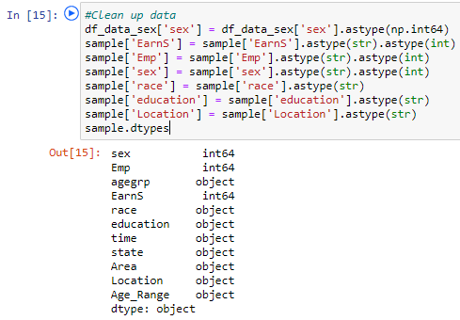
Data Preparation Continued
Instances where data was NaN or null were replaced with zeros in order for their data type to be converted to a numeric type.
Uploading data set all column data types to object by default. In order to perform a regression analysis, the Earnings (“EarnS” column) was changed to an integer and qualitative factors were changed to integers.

Slide 9
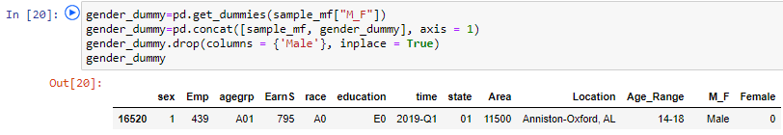
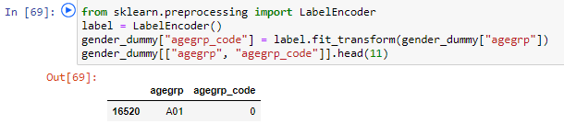
Categorical Variable Transformation
Transformation of Categorical Variables:
In order to perform regression analysis on multiple qualitative categorical variables (and the average salary per location), codes were assigned per category to observe their qualitative impact.
Two Functions Used:
For analyzing the impact of Gender on Earnings, the Get_Dummies() function in pandas was used to convert “Female” to 1 and “Male” to 0.
For analyzing age and timing categories, the LabelEncoder() API’s fit_transform() function was used to assign categories a respective numbering.

Slide 10
Findings (average per location)
Women made less than men on average and men had extreme high earning outliers
People in the 45 to 55 age group made the most money while the 14 to 18 age group made the least
People had higher average monthly earnings per location, the later in the year the salary was received

Slide 11
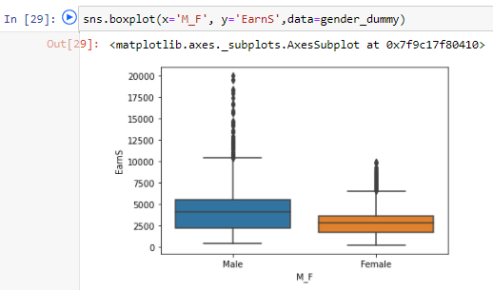
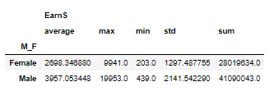
Finding #1 – Gender Impact
Women made lower salary than men on average by a mean difference of -$1,259 and a similar regression coefficient of -$1,281. This was despite the number of people employed being very close between genders.
Max earnings were significantly higher for men by nearly $10k per month; however, the high end is for men is an extreme outlier (e.g. Bill Gates). This indicates that even if you are male there is still a large discrepancy and other factors are at play.
Could be due to factors other than gender which are correlated to gender. For example, more high paying careers are selected by men rather than the careers paying different amounts based on gender.

Slide 12
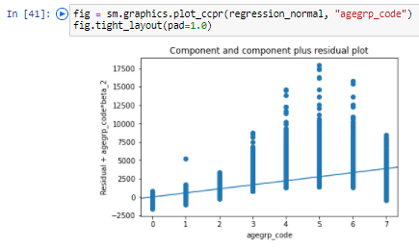
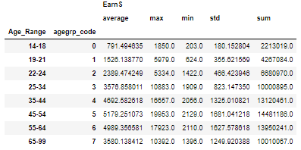
Finding #2 – Age Impact
People in the 45 to 55 age group made the most money with an average monthly salary of $5,179.25
Age adds roughly $551 for each increase in age category as indicated by the regression coefficient
The 14 to 18 age group made the least at $791.50
Could be due to people gaining experience and responsibilities as their career progresses
The decrease in salary after age 54 likely is in some part due to people retiring and no longer receiving a salary.

Slide 13
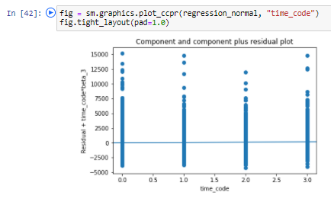
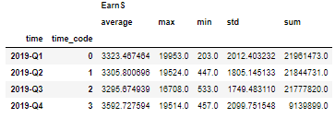
Finding #3 – Time Period
People had higher average earnings per location during the 4th quarter
This could be due to seasonal employment around end of year tax time and holidays
This could also be due to more salary being received at year end such as holiday bonuses/incentives
The quarter the salary is observed added about $50 per month for each additional quarter the salary was received; as indicated by the regression coefficient of 49.42

Slide 14
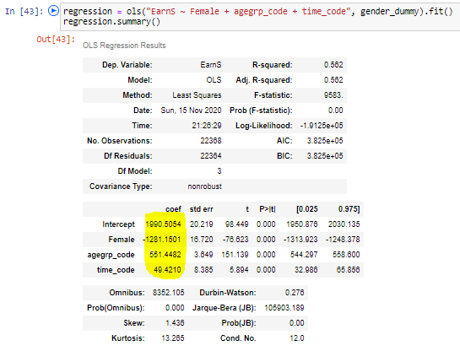
Regression Details

Slide 15
Conclusion (and caveats)
Findings indicated significant biases exist in the salaries received by US Citizens which may be unfairly benefiting/harming different categories of the US population. However, there are large caveats which point for the need to do additional work to prove biases in salary exist.
A caveat to the findings are that the testing implies a correlation and not necessarily a causation. This means that, for example, having male gender and being between the ages 45-54 will not cause you to automatically receive a good salary. However, it does imply that, all other factors held equal, being male and/or between the ages of 45-55 will be an advantage towards receiving a relatively higher salary.
Another large caveat with the data analysis findings are that only three categorical factors were included in testing. With an adjusted R-squared of 0.562 indicates that we are likely leaving out material factors. Obviously, looking at types of professions, education, experience levels would give us a better picture. This points to additional research and variables which should be included prior to forming a definitive conclusion.

